Slide 1
Array Structure

Slide 2
Contents
Arrays
Dynamically Allocated Arrays
Structures and Unions
Polynomials
Sparse Matrices
Strings

Slide 3
Array: definition
  “a set of consecutive memory locations”
  “a collection of data of the same type”
  “a set of pairs, <index, value>, such that each index that is defined has a value associated with it”

Slide 4
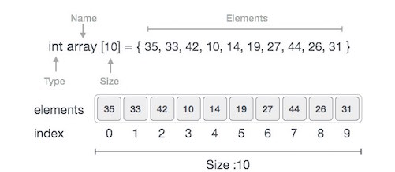
Array Representation
Data structure for one dimensional array

Slide 5
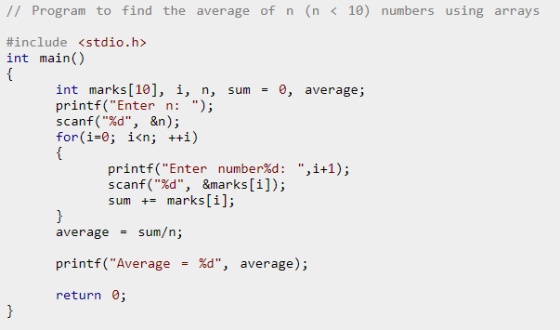
Sample Array Program
To find average of n numbers

Slide 6
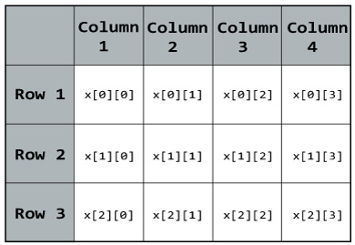
Multi Dimensional Arrays
2D Array:
float x[3][4];

Slide 7
Multi Dimensional Array
2D Array
x =
x[0]
x[1]
x[2]
3
5
6
7
10
21
32
52
32
25
73
54

Slide 8
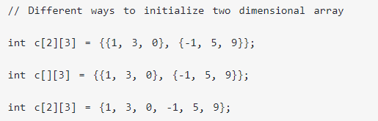
2D Array
How to initialize?

Slide 9
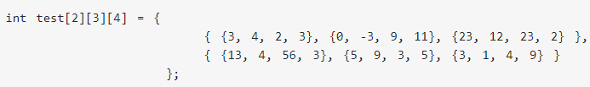
Multi Dimensional Array
3D Array

Slide 10
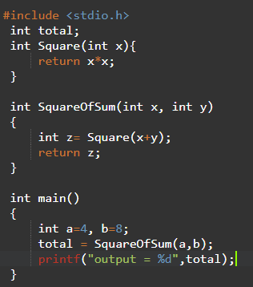
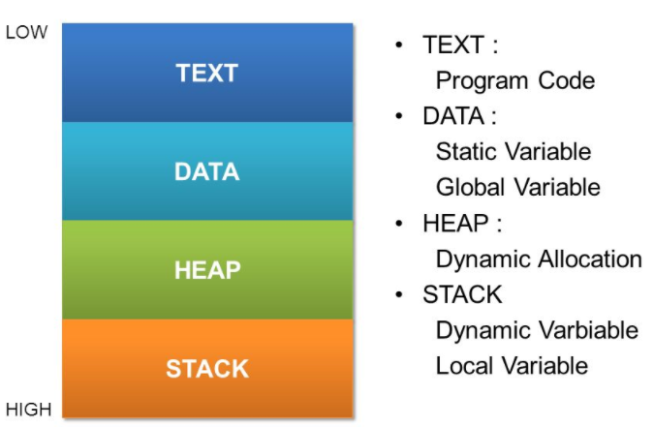
Dynamic Arrays
Application Memory

Slide 11
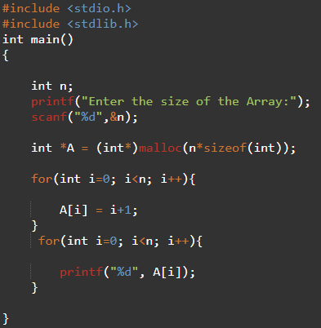
Dynamic Memory

Slide 12
2D Dynamic Memory
x
int **make2dArray(int rows, int cols)
{
/* create a two dimensional rows  cols array */
int **x, i;
/* get memory for row pointers */
MALLOC(x, rows * sizeof (*x));
/* get memory for each row */
for (i = 0; i < rows; i++)
MALLOC(x[i], cols * sizeof(**x);
return x;
}
void main()
{
int ** myArray;
myArray=make2dArray(5,10);
myArray[2][4]=6;
}
x[0]
rows
x[0][0]
cols

Slide 13
Structure
A collection of data items, where each item is identified as to its type and name
  struct {
    char name[10];
int age;
float salary;
} person;
strcpy(person.name,“PaulRajib”);
person.age=31;
person.salary=35000;

Slide 14
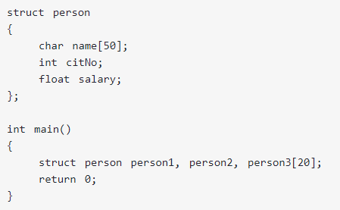
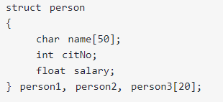
Structures

Slide 15
Structures
To create own structure data type
  humanBeing person1, person2;
Assignments
  person1=person2;
  Or
  strcpy(person1.name, person2.name);
  person1.age=person2.age;
  person1.salary=person2.salary;
typedef struct humanBeing {
char name[10];
int age;
float salary;
};
typedef struct {
char name[10];
int age;
float salary;
} humanBeing;
or

Slide 16
Structures
To embed a structure within a structure
  typedef struct {
  int month;
  int day;
  int year;
  } date;
  typedef struct humanBeing{
  char name[10];
  int age;
  float salary;
  date dob;
  } humanBeing;
person1.dob.month=12; person1.dob.day=3;
  person1.dob.year=1969;

Slide 17
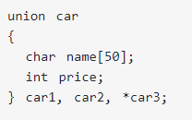
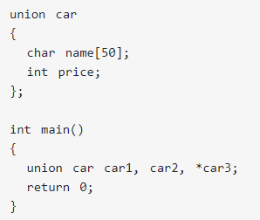
Union
A union declaration is similar to a structure
Fields of a union must share their memory space
Example

Slide 18
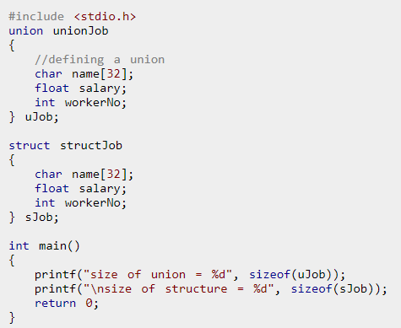
Structure vs. Union

Slide 19
Union: Example
typedef struct sexType{
enum tagField {female, male} sex;
union {
int children;
int beard;
} u ;
};
typedef struct humanBeing{
char name[10];
int age;
date dob;
sexType sexInfo;
};
#define FALSE 0
#define TRUE 1
humanBeing person1, person2;
person1.sexInfo.sex=male;
person1.sexInfo.u.beard=FALSE;
Or
person1.sexInfo.sex=female;
person1.sexInfo.u.children=4;

Slide 20
Self Referential Structures
One or more of its components is a pointer to itself
typedef struct list *listPtr;
typedef struct list {
char data;
listPtr link;
};
list item1, item2, item3;
item1.data = 'a';
item2.data = 'b';
item3.data = 'c';
item1.link = item2.link = item3.link = NULL;
item1.link = &item2;
item2.link = &item3;

Slide 21
Application of Array
Ordered list
  One dimensional array
  Polynomial: components will be numeric
  String: components can be non-numeric
Matrix
  Standard: multi-dimensional array
  Sparse matrix: one dimensional array
  Components may be numeric

Slide 22
Ordered List(1)
Example
  Days of a week
  (Sunday, Monday, Tuesday, Wednesday, Thursday, Friday, Saturday)
  Values in a deck of cards
  (Ace, 2, 3, 4, 5, 6, 7, 8, 9, 10, Jack, Queen, King)
  Years Switzerland fought in World War II: ()

Slide 23
Ordered List(2)
Operations
  Finding the length, n, of a list
  Reading the items in a list from left to right (or reversely)
  Retrieving the i-th item from a list, 0 ≤ i ≤ n
  Replacing the item in the i-th position of a list, 0 ≤ i ≤ n
  Inserting a new item in the i-th position of a list, 0 ≤ i ≤ n
  Deleting an item from the i-th position of a list, 0 ≤ i ≤ n

Slide 24
Polynomial ADT
Example of polynomials
A(x) = 3x⁶ + 2x⁵ + 4, B(x) = x⁴ + 10x³ + 3x² + 1
→ A(x) + B(x) =
Manipulation of symbolic polynomials
3x⁶
+ 2x⁵
+ x⁴
+ 10x³
+ 3x²
+ 5

Slide 25
Polynomial ADT
Structure Polynomial is
objects: ; a set of ordered pairs of <e_{i},a_{i}> where a_{i} in Coefficients and e_{i} in Exponents, e_{i} are integers >= 0
functions:
for all poly, poly1, poly2  Polynomial, coef Coefficients, expon  Exponents
Polynomial Zero( ) ::= return the polynomial,
p(x) = 0
Boolean IsZero(poly) ::= if (poly) return FALSE
else return TRUE
Coefficient Coef(poly, expon) ::= if (expon  poly) return its
coefficient else return Zero
Exponent Lead_Exp(poly) ::= return the largest exponent in poly
Polynomial Attach(poly,coef, expon) ::= if (expon  poly) return error
else return the polynomial poly
with the term <coef, expon>
inserted

Slide 26
Polynomial ADT
Polynomial Remove(poly, expon) ::= if (expon  poly) return the polynomial poly with the term whose exponent is expon deleted
else return error
Polynomial SingleMult(poly, coef, expon) ::= return the polynomial
poly • coef • x^{expon}
Polynomial Add(poly1, poly2) ::= return the polynomial
poly1 +poly2
Polynomial Mult(poly1, poly2) ::= return the polynomial
poly1 • poly2
End Polynomial

Slide 27
Polynomial ADT
/* d = a + b, where a, b, and d are polynomials */
d = Zero();
while (! IsZero(a) && ! IsZero(b)) do {
switch COMPARE(LeadExp(a), LeadExp(b)) {
case -1: /* if LeadExp(a) < LeadExp(b) */
d = Attach (d, Coef(b, LeadExp(b)), LeadExp(b));
b = Remove(b, LeadExp(b));
break;
case 0: /* if LeadExp(a) == LeadExp(b) */
sum = Coef(a, LeadExp(a)) + Coef(b, LeadExp(b));
if (sum) {
d = Attach(d, sum, LeadExp(a));
a = Remove(a, LeadExp(a));
b = Remove(b, LeadExp(b));
}
break;
case 1: /* if LeadExp(a) > LeadExp(b) */
d = Attach(d, Coef(a, LeadExp(a)), LeadExp(a));
a = Remove(a, LeadExp(a));
}
}
Insert any remaining terms of a or b into d
Return the largest expo in poly
Return the term poly

Slide 28
Polynomial ADT
  #define MAX_DEGREE 101
  typedef struct {
  int degree;
  float coef[MAX_DEGREE];
  } polynomial;
  n < MAX_DEGREE
    polynomial a;
    a.degree = n, a.coef[i] = a_{n-i}, 0≤i≤n
A(x) = 3x⁶ + 2x⁵ + 41
How about 2x¹⁰⁰⁰ + 1 ?
a
6
3
2
0
0
0
0
41
degree
coef[]

Slide 29
Polynomial Representation
#define MAX_TERMS 100
  typedef struct {
  float coef;
  int expon;
  } polynomial;
  polynomial terms[MAX_TERMS];
  int starta, finisha, startb, finishb, avail;
  starta=0; finisha=1; startb=2; finishb=5; avail=6;
A(x) = 2x¹⁰⁰⁰ + 1,
B(x) = x⁴ + 10x³ + 3x² + 1
starta
finisha
startb
finishb
avail
terms[]
coef
2
1
1
10
3
1
expon
1000
0
4
3
2
0

Slide 30
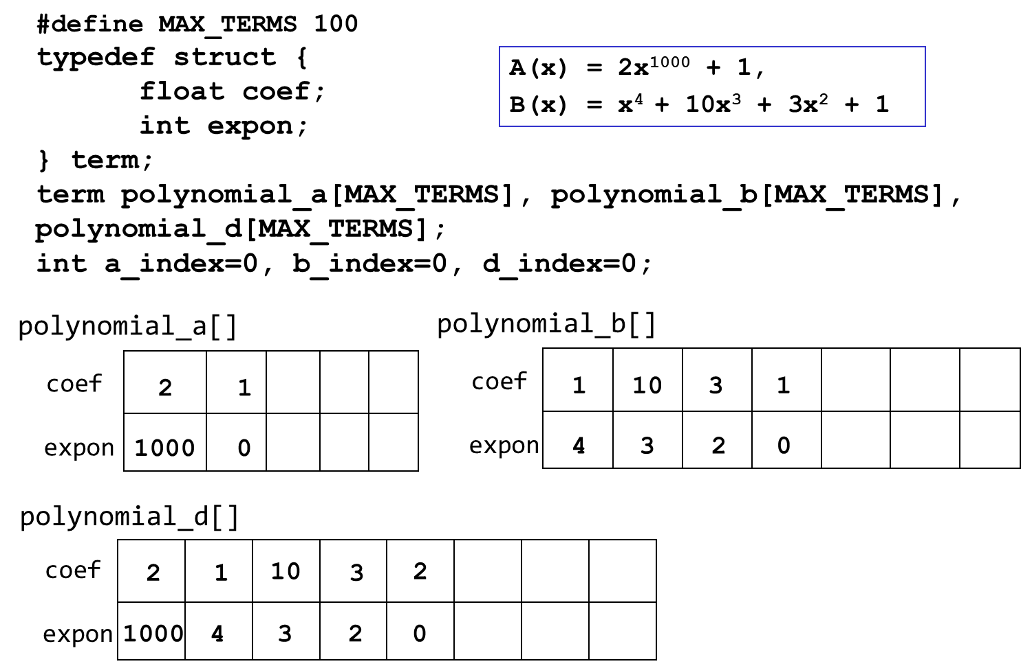
Polynomial Addition

Slide 31
Matrix
  m rows and n columns
  Standard representation : two-dimensional array as a[MAX_ROWS][MAX_COLS]
  a[0][0]=-27;
  a[1][2]=-2;
  a[3][1]=8;

Slide 32
Sparse Matrix
  Sparse matrix has many zero entries
  two-dimensional array wastes space
  Represent using the triple <row, col, value>
no. of non-zero elements
no. of total elements
<< small
15
8
15
36
 | col0 | col1 | col2 | col3 | col4 | col5
row0 | 15 | 0 | 0 | 22 | 0 | -15
row1 | 0 | 11 | 3 | 0 | 0 | 0
row2 | 0 | 0 | 0 | -6 | 0 | 0
row3 | 0 | 0 | 0 | 0 | 0 | 0
row4 | 91 | 0 | 0 | 0 | 0 | 0
row5 | 0 | 0 | 28 | 0 | 0 | 0
 | col0 | col1 | col2
row0 | -27 | 3 | 4
row1 | 6 | 82 | -2
row2 | 109 | -64 | 11
row3 | 12 | 8 | 9
row4 | 48 | 27 | 47

Slide 33
Sparse Matrix Example
  n = 2 billion (and growing by 1 million a day)
  n x n array of ints ➔ 16 * 10¹⁸ bytes (16 * 10⁹ GB)
  each page links to 10 (say) other pages on average
  on average there are 10 nonzero entries per row
  space needed for nonzero elements is approximately
  20 billion x 4 bytes = 80 billion bytes (80 GB)

Slide 34
Matrix Representation
  #define MAX_TERMS 101
  typedef struct {
  int row;
  int col;
  int value;
  } term;
  term a[MAX_TERMS];
Number of elements
Number of columns
Number of rows
[0]
[1]
[2]
[0]
 | row | col | value
a[0] | 5 | 3 | 4
a[1] | 0 | 1 | 3
a[2] | 1 | 2 | -2
a[3] | 3 | 1 | 8
a[4] | 4 | 0 | 48
[1]
[2]
→
[3]
[4]

Slide 35
Approximate Memory Requirement
500 x 500 matrix with 1994 nonzero elements, 4 bytes per element
2D array: 500 x 500 x 4 = 1M bytes
1D array of triples: 3 x 1994 x 4 ≈ 23K bytes

Slide 36
Transposing a Matrix(1)
Transpose operation (A(i,j) → A(j,i))
 | row | col | value
a[0] | 6 | 6 | 8
a[1] | 0 | 0 | 15
a[2] | 0 | 3 | 22
a[3] | 0 | 5 | -15
a[4] | 1 | 1 | 11
a[5] | 1 | 2 | 3
a[6] | 2 | 3 | -6
a[7] | 4 | 0 | 91
a[8] | 5 | 2 | 28
 | row | col | value
b[0] | 6 | 6 | 8
b[1] | 0 | 0 | 15
b[2] | 0 | 4 | 91
b[3] | 1 | 1 | 11
b[4] | 2 | 1 | 3
b[5] | 2 | 5 | 28
b[6] | 3 | 0 | 22
b[7] | 3 | 2 | -6
b[8] | 5 | 0 | -15
→

Slide 37
Transposing Matrix(2)
for each row i
take element <i,j,value> and store it as element <j,i,value>
 | row | col | value
a[0] | 6 | 6 | 8
a[1] | 0 | 0 | 15
a[2] | 0 | 3 | 22
a[3] | 0 | 5 | -15
a[4] | 1 | 1 | 11
a[5] | 1 | 2 | 3
a[6] | 2 | 3 | -6
a[7] | 4 | 0 | 91
a[8] | 5 | 2 | 28
 | row | col | value
a[0] | 6 | 6 | 8
a[1] | 0 | 0 | 15
a[2]
a[3]
a[4]
a[5]
a[6]
a[7]
a[8]
a[??]
3 | 0 | 22

Slide 38
Transposing a Matrix(3)
for all elements in column j
place element <i,j,value> in element <j,i,value>
 | row | col | value
a[0] | 6 | 6 | 8
a[1] | 0 | 0 | 15
a[2] | 0 | 3 | 22
a[3] | 0 | 5 | -15
a[4] | 1 | 1 | 11
a[5] | 1 | 2 | 3
a[6] | 2 | 3 | -6
a[7] | 4 | 0 | 91
a[8] | 5 | 2 | 28
 | row | col | value
a[0] | 6 | 6 | 8
a[1]
a[2]
a[3]
a[4]
a[5]
a[6]
a[7]
a[8]
0 | 0 | 15
0 | 4 | 91
1 | 1 | 11
2 | 1 | 3
2 | 5 | 28
3 | 0 | 22
3 | 2 | -6
5 | 0 | -15

Slide 39
void transpose(term a[], term b[])
{
/* b is set to the transpose of a*/
int n, i, j, currentb;
n = a[0].value; /* total number of elements */
b[0].row = a[0].col; /* rows in b = columns in a */
b[0].col = a[0].row; /* columns in b = rows in a */
b[0].value = n;
if (n > 0) { /* non-zero matrix*/
currentb = 1;
for (i=0; i<a[0].col; i++){ /*transpose by the column*/
for (j = 1; j <= n; j++){
if (a[j].col == i){
b[currentb].row = a[j].col;
b[currentb].col = a[j].row;
b[currentb].value = a[j].value;
currentb++;
} /* if a[j].col */
} /* for j */
} /* for i */
} /* if n */
}
→ O (columns · elements)

Slide 40
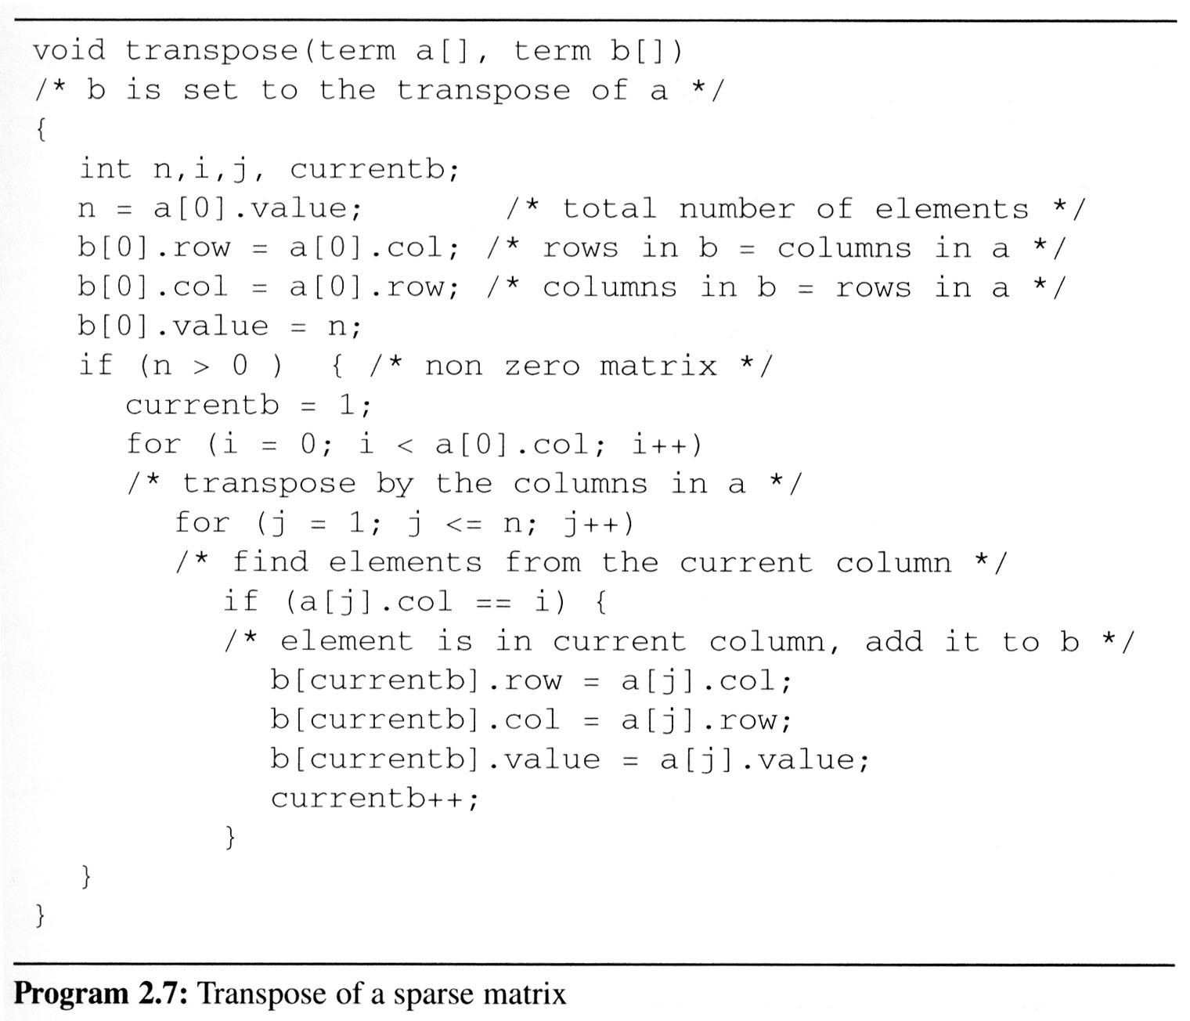
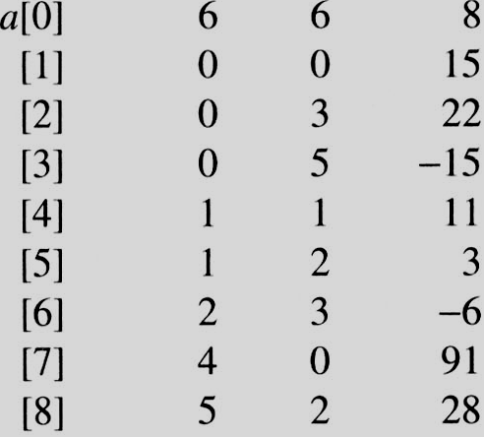
i=0 j=1
i=0 j=1
a[j]= 0 == i
i=0 j=2
i=0 j=2
a[j]=3 != i
i=0 j=3
i=0 j=3
a[j] = 5 != i
i=0 j=4
i=0 j=4
a[j].col = 1 a[j].col != i
i=0 j=5
i=0 j=5
a[j].col = 2 a[j].col != i
i=0 j=6
i=0 j=6
a[j].col = 3 != i
i=0 j=7
i=0 j=7
a[j].col = 0 == i
i=0 j=8
i=0 j=8
a[j].col = 2 != i
i=1 j=1
i=1 j=1
a[j].col = 0 != i
i=1 j=2
i=1 j=2
a[j].col = 3 != i
i=1 j=3
i=1 j=3
a[j].col = 5 != i
i=1 j=4
i=1 j=4
a[j].col = 1 == i
i=1 j=5
i=1 j=5
a[i].col = 2 != i
i=1 j=6
i=1 j=6
a[j].col = 3 != i
i=1 j=7
i=1 j=7
a[j] = 0 != i
i=1 j=8
EX: A[6][6] transpose to B[6][6]
i=1 j=8
a[i].col = 2 != i
Matrix A
Row Col Value
Set Up row & column in B[6][6]
Row Col Value
0 6 6 8
1 0 0 15
2 0 4 91
3 1 1 11
And So on…

Slide 41
Fast Matrix Transpose
 | row | col | value
a[0] | 6 | 6 | 8
a[1] | 0 | 0 | 15
a[2] | 0 | 3 | 22
a[3] | 0 | 5 | -15
a[4] | 1 | 1 | 11
a[5] | 1 | 2 | 3
a[6] | 2 | 3 | -6
a[7] | 4 | 0 | 91
a[8] | 5 | 2 | 28
 | row | col | value
a[0] | 6 | 6 | 8
a[1]
a[2]
a[3]
a[4]
a[5]
a[6]
a[7]
a[8]
0 | 0 | 15
3 | 0 | 22
2 elements in row 0
1 element in row 1
2 elements in row 2
3 | 0 | 22

Slide 42
Fast Matrix Transpose
void fastTranspose(term a[], term b[])
{
int rowTerms[MAX_COL], startingPos[MAX_COL];
int i,j, numCols = a[0].col, numTerms = a[0].value;
b[0].row = numCols; b[0].col = a[0].row;
b[0].value = numTerms;
if (numTerms > 0) {/* non-zero matrix*/
for(i = 0; i < numCols; i++) { rowTerms[i] = 0; }
for(i=1; i<= numTerms; i++){rowTerms[a[i].col]++;}
startingPos[0] = 1;
for(i = 1; i < numCols; i++){
startingPos[i]=startingPos[i-1]+rowTerms[i-1];
}
for(i = 1; i <= numTerms; i++) {
j = startingPos[a[i].col]++;
b[j].row = a[i].col; b[j].col = a[i].row;
b[j].value = a[i].value;
}
}
}
→ O (columns + elements)

Slide 43
Number of
non-zero elements
in each row of transpose matrix
Starting position of
each row of transpose matrix
Original matrix
 | row | col | value
a[0] | 6 | 6 | 8
a[1] | 0 | 0 | 15
a[2] | 0 | 3 | 22
a[3] | 0 | 5 | -15
a[4] | 1 | 1 | 11
a[5] | 1 | 2 | 3
a[6] | 2 | 3 | -6
a[7] | 4 | 0 | 91
a[8] | 5 | 2 | 28
rowTerms
startingPos
[0]
[1]
[2]
[3]
[4]
[5]
0
0
0
0
0
0
[0]
[1]
[2]
[3]
[4]
[5]
1
1
2
1
3
1
2
4
1
6
2
8
1
8

Slide 44
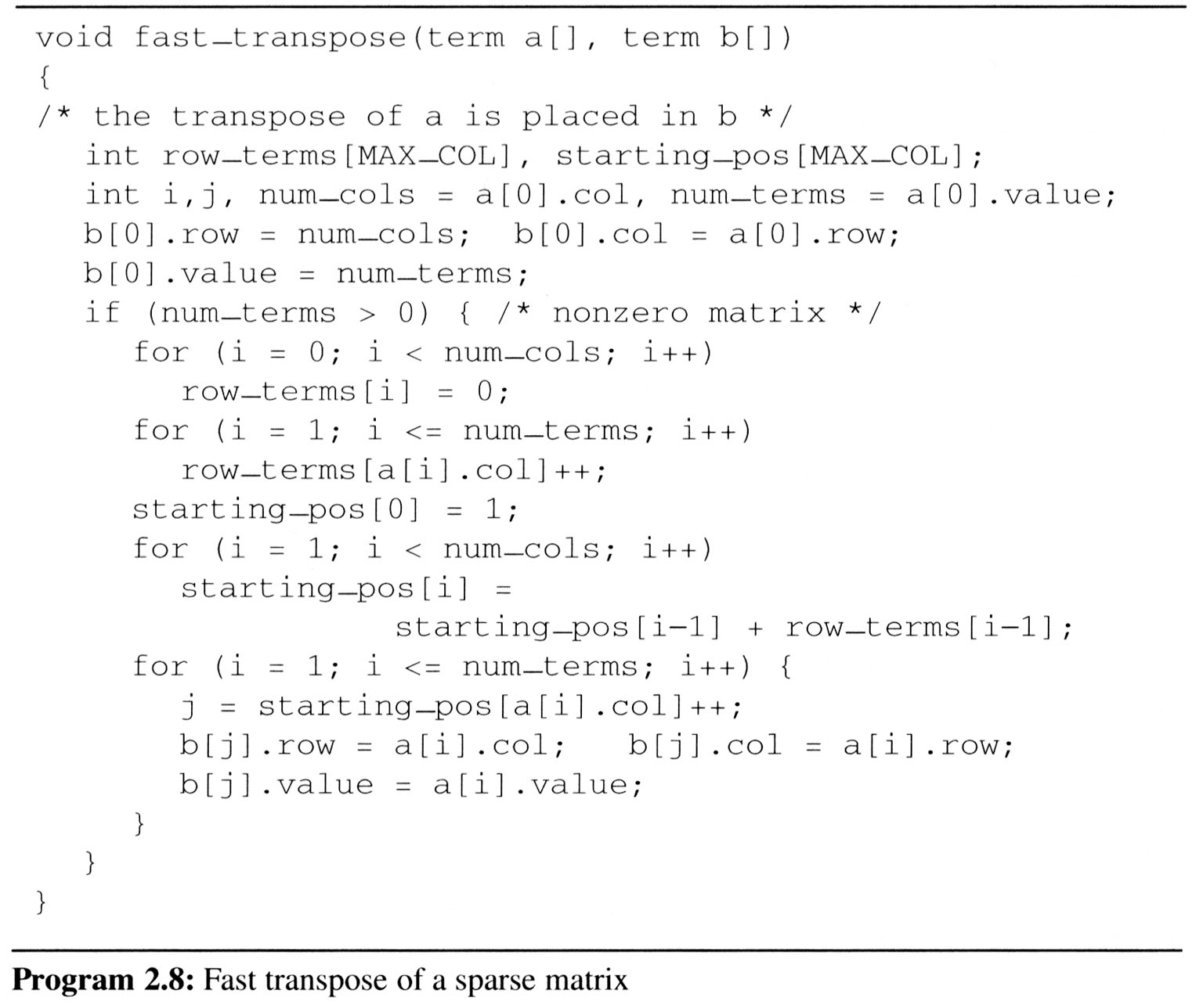
[0] [1] [2] [3] [4] [5]
row_terms
0
1
2
0
1
0
1
2
0
1
2
0
0
1
#col = 6
#term = 6
starting_pos
1
3
4
6
8
8
Matrix A
Row Col Value

Slide 45
[0] [1] [2] [3] [4] [5]
row_terms = 2 1 2 2 0 1
starting_pos = 1 3 4 6 8 8
[0] [1] [2] [3] [4] [5]
row_terms = 2 1 2 2 0 1
starting_pos = 2 3 4 6 8 8
[0] [1] [2] [3] [4] [5]
row_terms = 2 1 2 2 0 1
starting_pos = 2 3 4 7 8 8
[0] [1] [2] [3] [4] [5]
row_terms = 2 1 2 2 0 1
starting_pos = 2 3 4 7 8 9
[0] [1] [2] [3] [4] [5]
row_terms = 2 1 2 2 0 1
starting_pos = 2 4 4 7 8 9
[0] [1] [2] [3] [4] [5]
row_terms = 2 1 2 2 0 1
starting_pos = 2 4 5 7 8 9
[0] [1] [2] [3] [4] [5]
row_terms = 2 1 2 2 0 1
starting_pos = 2 4 5 8 8 9
[0] [1] [2] [3] [4] [5]
row_terms = 2 1 2 2 0 1
starting_pos = 3 4 5 8 8 9
[0] [1] [2] [3] [4] [5]
row_terms = 2 1 2 2 0 1
starting_pos = 3 4 6 8 8 9
I = 1
I = 2
I = 3
I = 4
I = 5
I = 6
I = 7
I = 8
Matrix A
Row Col Value
Row Col Value
0 6 6 8
1 0 0 15
2 0 4 91
3 1 1 11
4 2 1 3
5 2 5 28
6 3 0 22
7 3 2 -6
8 5 0 -15

Slide 46
String ADT
What is a STRING ?
  It is nothing but an ARRAY on Characters.
String Declaration
  Method 1
  Method 2
'\0' represents the end of the string. It is also referred as String terminator & Null Character.

Slide 47
String ADTs
C String functions
  char *strcat(char *dest, char *src)
  char *strncat(char *dest, char *src, int n)
  int strcmp(char *str1, char *str2)
  int strncmp(char *str1, char *str2, int n)
  char *strcpy(char *dest, char *src)
  char *strncpy(char *dest, char *src, int n)
  size_t strlen(char *s)
  char *strchr(char *s, int c)
  char *strtok(char *s, char *delimiters )
  char *strstr(char *s, char *pat)
  size_t strspn(char *s, char *spanset)
  size_t strcspn(char *s, char *spanset)
  char *strpbrk(char *s, char *spanset)

Slide 48
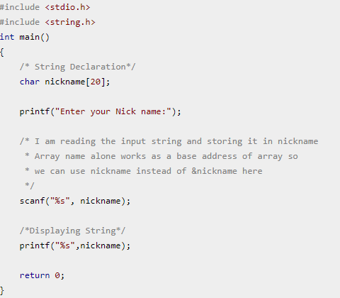
String ADTs
read() and write() operation using String

Slide 49
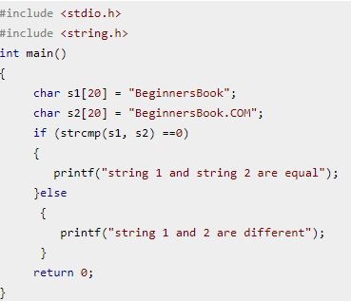
String ADTs
C string function - strcmp

Slide 50
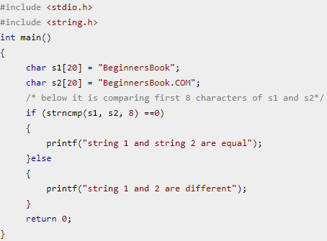
String ADTs
C string function - strnmp

Slide 51
String operation
void main()
{
char s[MAX_SIZE]=“amobile”;
char t[MAX_SIZE]=“uto”;
stringins(s,t,1);
printf(“%s\n”, s);
return;
}
s
a
m
o
b
i
l
e
\0
t
u
t
o
\0
memset(string, 0, sizeof(string));
temp
\0
strncpy(temp,s,i);
char string[MAX_SIZE], *temp=string;
temp
a
\0
strcat(temp,t);
temp
a
u
t
o
\0
strcat(temp, s+i);
temp
a
u
t
o
m
o
b
i
l
e
\0
strcpy(s, temp);
s
a
u
t
o
m
o
b
i
l
e
\0

Slide 52
Pattern Matching
String: Missy the monkey is missing
Pattern: monkey
Missy the monkey is missing
monkey
monkey
monkey
monkey
monkey
monkey
monkey
monkey
monkey
monkey
monkey
Missy the monkey is missing
monkey
monkey
monkey
monkey
monkey
monkey
monkey
monkey
monkey
monkey
monkey
Missy the monk is missing
monkey
monkey
monkey
monkey
monkey
monkey
monkey
monkey
monkey
monkey
monkey

Slide 53
Simulation
a | a | b | \0
(a) pattern
j
lastp
a | b | a | b | a | a | b | b | a | a | \0
(b) no match
start
endmatch
lasts
a | b | a | b | a | a | b | b | a | a | \0
(c) no match
start
endmatch
lasts
a | b | a | b | a | a | b | b | a | a | \0
(d) no match
start
endmatch
lasts
a | b | a | b | a | a | b | b | a | a | \0
(e) no match
start
endmatch
lasts
a | b | a | b | a | a | b | b | a | a | \0
(f) match
start
endmatch
lasts
→ O(length of string · length of pattern))

Slide 54
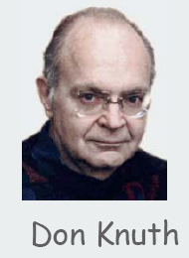


KMP Pattern Matching
Donald E. Knuth, James H. Morris, JR, and Vaughan R. Pratt, “Fast Pattern Matching in Strings,” SIAM Journal of Computing, vol.6, no.2, 1977.
(Chapter 2, p.98)
string
Non KMP algorithm
She can help me to study data structure
hello
hello
hello
s = ‘…abca??????’
Pattern: hello
pat = ‘abcabcac’
pat = ‘abcabcac’

Slide 55
KMP Algo
Main Idea
a | b | c | x | a | b | c | d | a | b
x | a | b | c | d | a | b | c | d | a
b | c | y
a | b | c | d | a | b | c | y
Prefix or Suffix
Prefix or Suffix

Slide 56
Failure Function
Substring calculation
f(j) = largest i < j, such that p₀ p₁ ... p_{i} = p_{j-i}p_{j-i+1} … p_{j}
if such an i ≥ 0 exists
-1, otherwise
Failure function example 1)
j 0 1 2 3 4 5 6 7
pat a b c a b c a c
f(j)
-1
–1
–1
0
1
2
3
-1

Slide 57
Pattern matching Algo(1)
int pmatch (char *string, char *pat)
{
int i=0, j=0,
lens=strlen(string), lenp=strlen(pat);
while (i < lens && j < lenp){
if (string[i] == pat[j]) { i++; j++; }
else if (j == 0) i++;
else j = failure[j-1]+1;
}
return (j == lenp ? i-lenp : -1);
}

Slide 58
Pattern matching Algo(2)
void fail (char *pat)
{
int n = strlen(pat);
failure[0] = -1;
for (j = 1; j < n; j++){
i = failure[j-1];
while (pat[j] != pat[i+1] && i>=0)
i = failure[i];
if (pat[j] == pat[i+1]) failure[j] = i+1;
else failure[j] = -1;
}
}

Slide 59
Summary
The Array as an Abstract Data Type
  Data structure
  Functions
Structures and Unions
  Similarity and Difference
The Polynomial Abstract Data Type
  Data structure
  Addition
The Sparse Matrix Abstract Data Type
  Data structure
  Transpose
The String Abstract Data Type
  Pattern matching algorithm

Slide 60
Thank You
Q & A
12th March, 2018

